Slide 1
CLUSTERING ASSIGNMENT
Affinity Propagation:
Affinity propagation (AP) is a clustering algorithm based on the concept of "message passing" between data points.Affinity propagation does not require the number of clusters to be determined or estimated before running the algorithm.
Affinity propagation finds "exemplars," members of the input set that are representative of clusters. Affinity Propagation can be interesting as it chooses the number of clusters based on the data provided.
The main Disadvantage of Affinity Propagation is its complexity.The Advantage of Affinity Propagation is most appropriate for small to medium sized datasets.

Slide 2
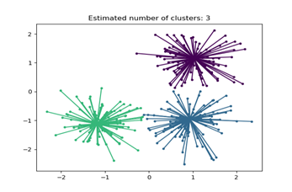

Slide 3
Mean Shift
Mean Shift is a technique for grouping comparable data factors into clusters primarily based on their inherent characteristics, with our previous understanding of the number of clusters
Mean Shift is a clustering algorithm used to pick out dense areas in a dataset and assign facts and factors to their respective clusters. , it discovers clusters based totally on the density of information points within the function area.

Slide 4
The Mean Shift algorithm is a mode-seeking algorithm that finds the most common values in the data and groups the data points around those values.
Advantages
  It can handle arbitrary data shapes and sizes.
  It doesn’t require prior knowledge of the number of clusters.
  It doesn’t make assumptions about the distribution of data points.
  It can work well with noisy data.

Slide 5
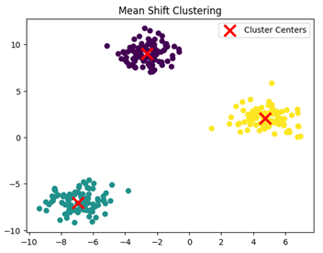
Disadvantages
  Mean shift is computationally expensive, especially on large datasets.
  The algorithm requires a careful selection of the bandwidth parameter, which can be difficult in some cases.

Slide 6
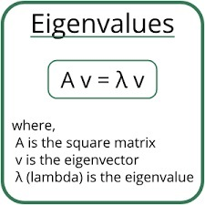
Spectral clustering:
Spectral clustering is a machine learning algorithm in scikit-learn that uses graph theory to identify clusters in a dataset.Spectral Clustering is a variant of the clustering algorithm that uses the connectivity between the data points to form the clustering.
It uses eigenvalues and eigenvectors of the data matrix to forecast the data into lower dimensions space to cluster the data points.

Slide 7
Eigen’ is a German word that means ‘proper’ or ‘characteristic’ eigenvalues have
many purposes, including:
  Analyzing linear transformations
  Identifying instability roots
  Reducing noise in data
  Simplifying complex data
The three major steps involved in Spectral Clustering Algorithm are:
  constructing a similarity graph
  projecting data onto a lower-dimensional space
  and clustering the data

Slide 8
Advantages
  Flexible
  Fast
  Can handle non-linear data
  Can handle mixed data types
Disadvantages
  Complex concept
  Sensitive to noise:
  Requires memory
  Requires user to specify number of clusters

Slide 9
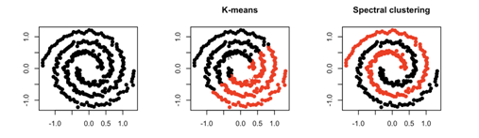

Slide 10
DBSCAN Clustering
DBSCAN stands for Density-Based Spatial Clustering of Applications with Noise
DBSCAN clusters points that are close together, and leaves sparse areas as "noise". It's an unsupervised learning method that doesn't require the number of clusters to be known beforehand.
There are two different parameters to calculate the density-based clustering
E_{PS}: It is considered as the maximum radius of the neighborhood.
MinPts: MinPts refers to the minimum number of points in an Eps neighborhood of that point.

Slide 11
Advantages
DBSCAN can:
  Find clusters with any shape
  Locate clusters that aren't connected to other groups
  Work well with noisy data
Disadvantages
DBSCAN doesn't work well with:
  Datasets with varying densities
  Datasets that are sparse

Slide 12
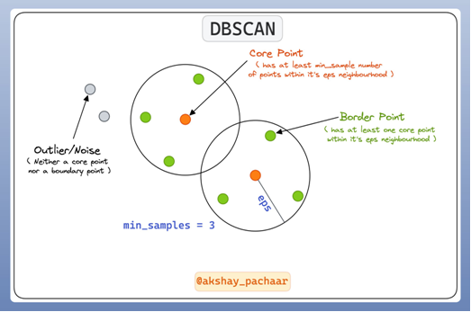

Slide 13
OPTICS Clustering
OPTICS Clustering stands for Ordering Points To Identify Cluster Structure
It is a algorithm for finding density-based clusters in spatial data.It require two parameter
Core Distance:
The smallest radius needed to designate a specific location as a core point. If the factor is not a Core factor, its Core Distance is unknown.
Reachability Distance:
Reachability Distance is defined in relation to q(Let), another data point.

Slide 14
Advantages
  Ability to handle clusters of varying densities − OPTICS can handle clusters that have varying densities, unlike some other clustering algorithms that require clusters to have uniform densities.
  Ability to handle noise − OPTICS can identify noise data points that do not belong to any cluster, which is useful for removing outliers from the dataset.
Disadvantages
  Sensitivity to parameters − OPTICS requires careful tuning of its parameters, such as the min_samples and xi parameters, which can be challenging.
  Computational complexity − OPTICS can be computationally expensive for large datasets, especially when using a high min_samples value.

Slide 15
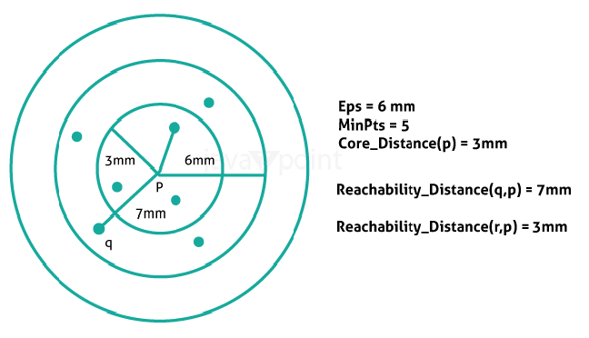

Slide 16
BIRCH Clustering
BIRCH stands for Balanced Iterative Reducing and Clustering using Hierarchies
It is a clustering algorithm that can cluster large datasets by first generating a small and compact summary of the large dataset that retains as much information as possible. This smaller summary is then clustered instead of clustering the larger dataset.
BIRCH has one major drawback – it can only process metric attributes. A metric attribute is any attribute whose values can be represented in Euclidean space i.e., no categorical attributes should be present.
.

Slide 17
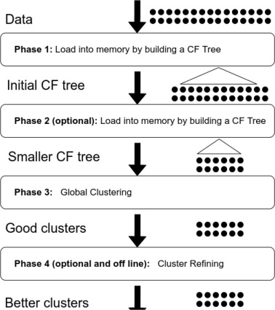
It consists four phases

Slide 18
Advantages
  scalability − BIRCH is designed to handle large datasets efficiently by using a tree like structure to represent the clusters.
  Memory efficiency − BIRCH uses CF and SCF data structures to summarize the statistical properties of the data points, which reduces the memory required to store the clusters.
  Fast clustering − BIRCH can cluster the data points quickly because it uses an incremental clustering approach.

Slide 19
Disadvantages
  Sensitivity to parameter settings − The performance of BIRCH clustering can be sensitive to the choice of parameters, such as the maximum number of CFs that can be stored in a node and the threshold value used to create subclusters.
  Limited ability to handle non-spherical clusters − BIRCH assumes that the clusters are spherical, which means it may not perform well on datasets with nonspherical clusters.
  Limited flexibility in the choice of distance metric − BIRCH uses the Euclidean distance metric by default, which may not be appropriate for all datasets.

